Slide 1
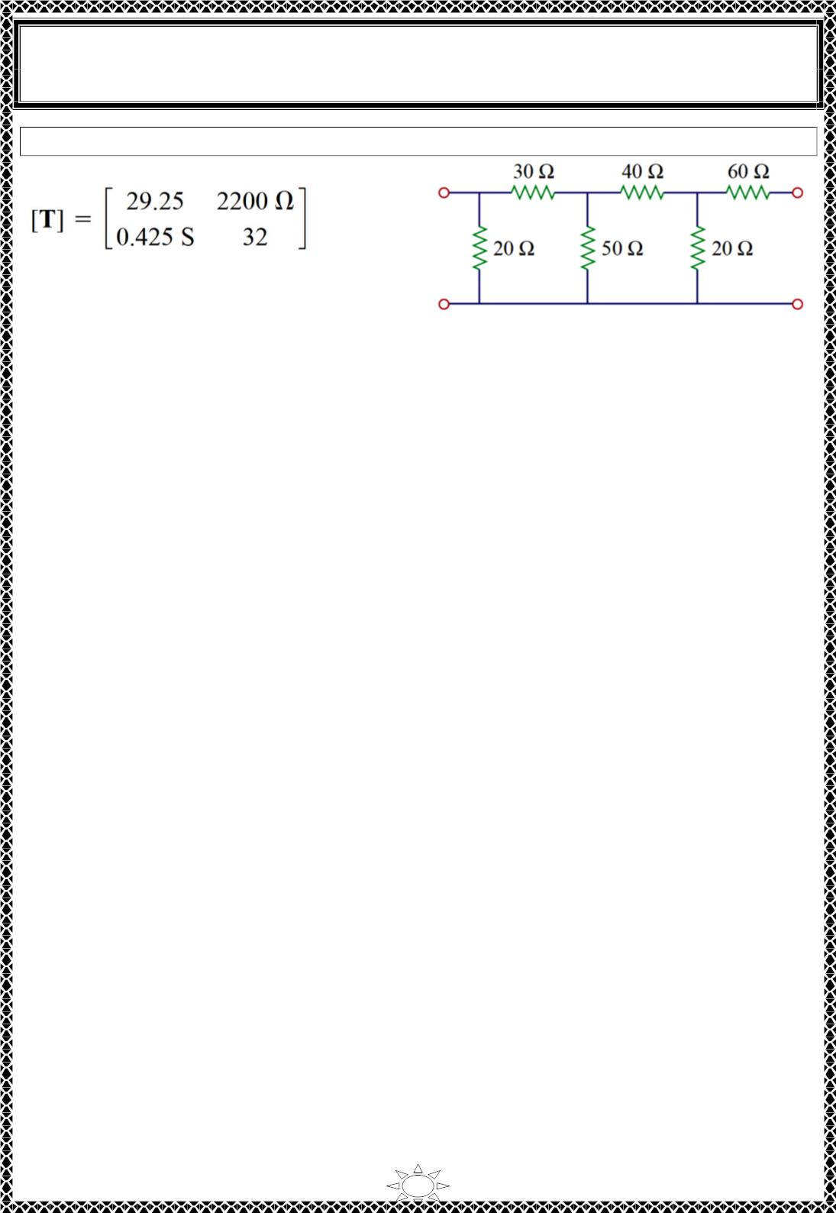
University of Diyala
Engineering College
Electronic Department
Electrical Circuits
2nd Class
Lecturer : Wisam N. AL-Obaidi
Year (2015-2016)
H.W.14: Obtain the ABCD parameter representation of the circuit in Fig.
Answer:
Trail Version
Trail Version
Trail Version
Trail Version
Trail Version
Trail Version
Trail Version
Trail Version
Trail Version
Trail Version
Trail Version
Trail Version
Trail Version
34

Slide 2
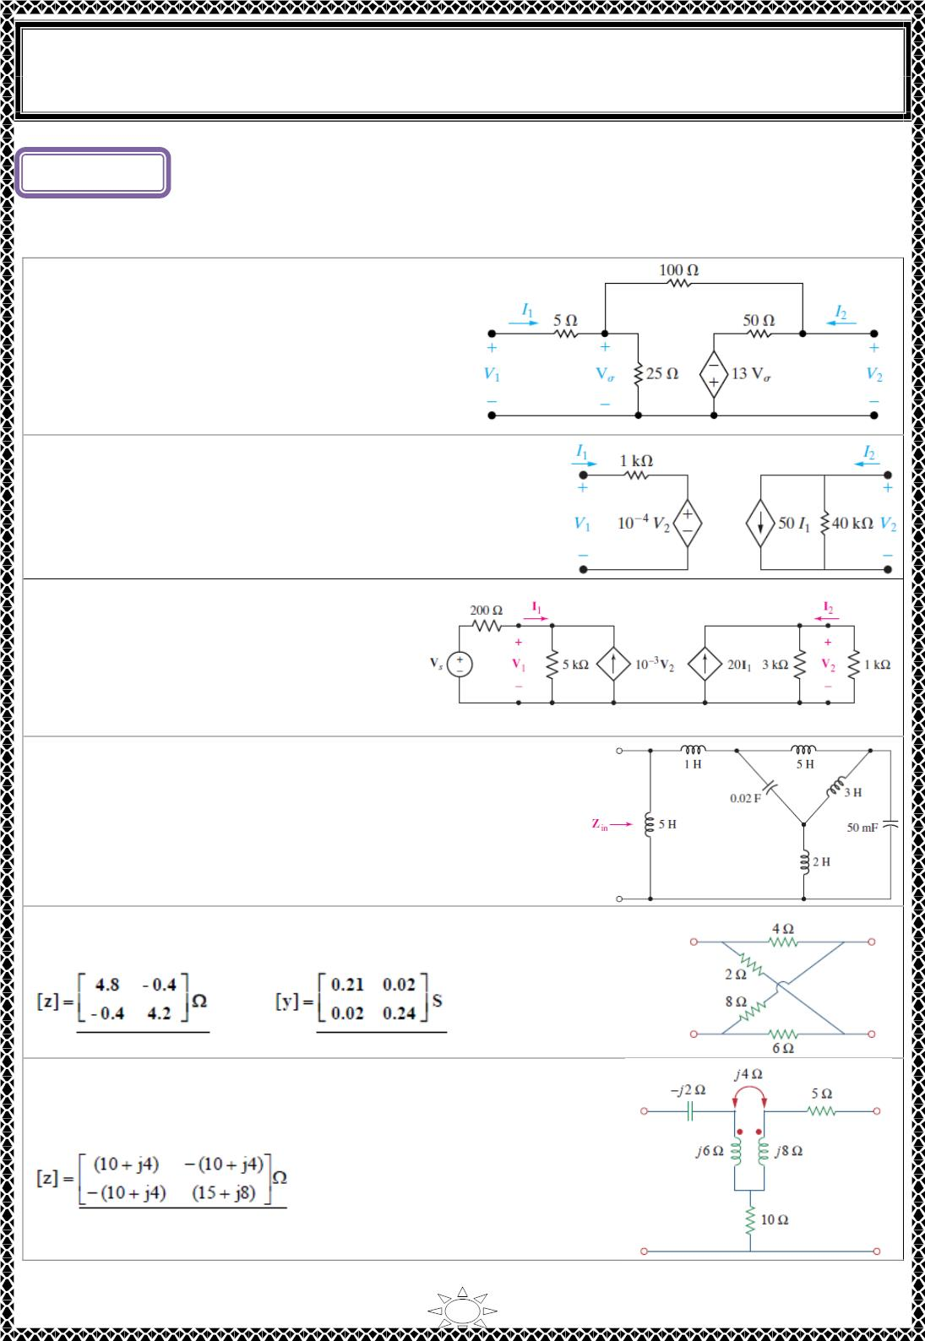
University of Diyala
Engineering College
Electronic Department
Electrical Circuits
2nd Class
Lecturer : Wisam N. AL-Obaidi
Year (2015-2016)
Lecture ()
Two-Port Networks
Problems
H.W. (1): Find the g parameters for the
operational amplifier circuit shown in Fig.
[Answer: g = 80 mS, g = -0.2,
11
12
g = -5, g = 25 Ω,]
21
22
H.W. (2): Find the transmission parameters for the
circuit in Fig.
[Answer: A = −ퟒ × ퟏퟎ^{ꢀퟒ}, B = −20,
C = −0.5 μS, D = −0.02]
H.W.(3): Find y and Z_{out} for the
terminated two-port shown in Fig.
Trail Version
Trail Version
Trail Version
Trail Version
Trail Version
Trail Version
Trail Version
Trail Version
Trail Version
Trail Version
Trail Version
Trail Version
Trail Version
[Answer: 17.6
ퟐ × ퟏퟎ^{−ퟒ}
−ퟏퟎ^{−ퟑ}
_{−ퟑ}] (푺)]
: [
−ퟑ
−ퟒ × ퟏퟎ
ퟐퟎ. ퟑ × ퟏퟎ
H.W.(4): Determine the input impedance 푍 of the
ꢁ푛
one‐port shown in Fig. if 휔 is equal to (푎)50푟푎푑/푠; (푏)
1000 푟푎푑/푠.
[Answer:]
H.W.(5): Determine the 푧 and 푦 parameters for the circuit in Fig.
[Answer:]
,
H.W.(6): Obtain the 푧 parameters for the network in Fig.
[Answer:]
1

Slide 3
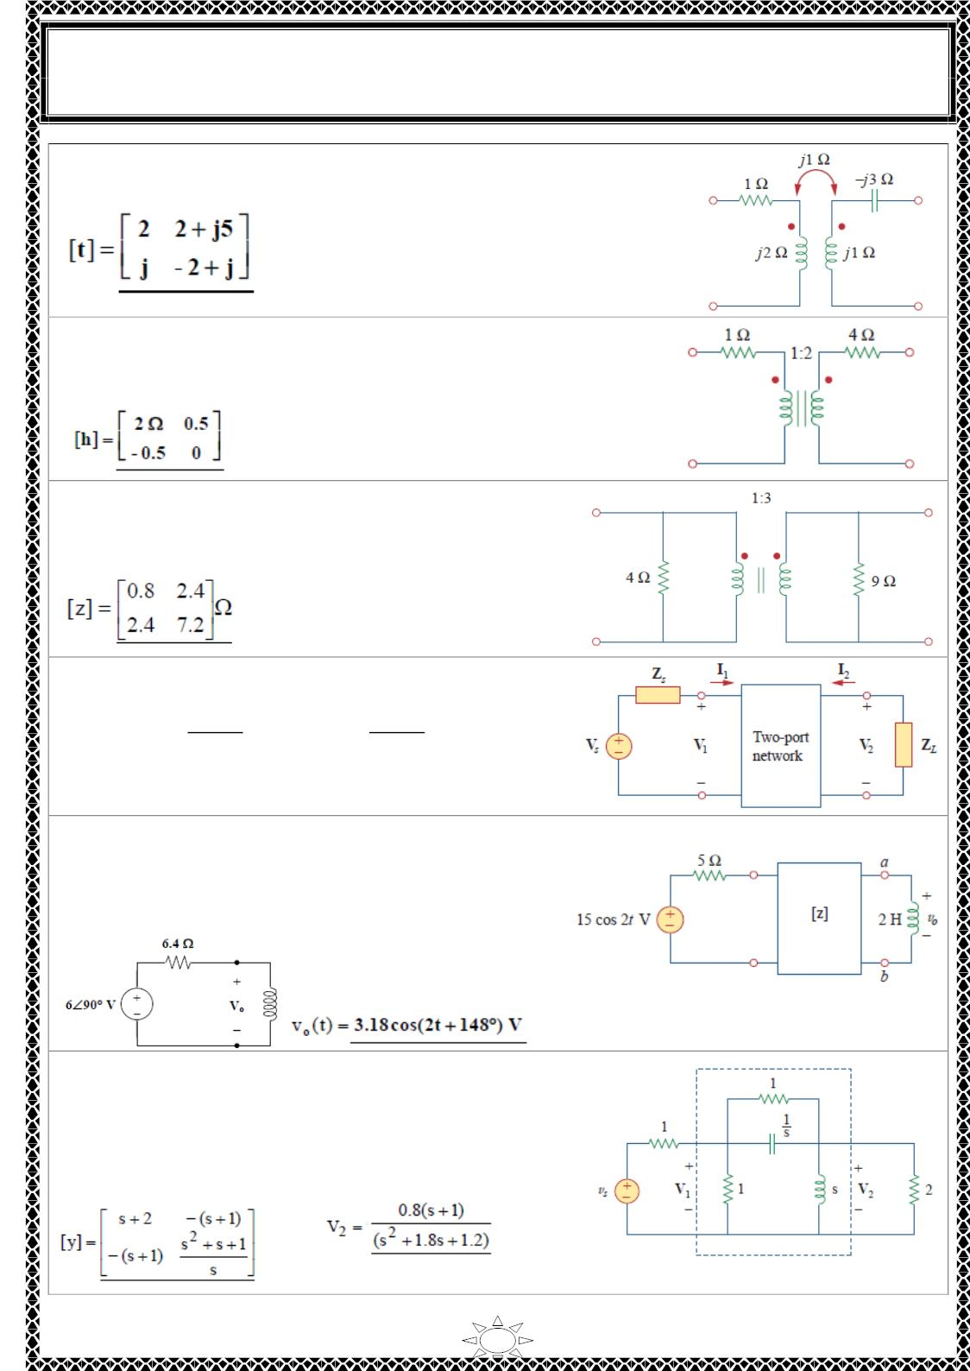
University of Diyala
Engineering College
Electronic Department
Electrical Circuits
2nd Class
Lecturer : Wisam N. AL-Obaidi
Year (2015-2016)
H.W.(7): Obtain the 푡 parameters for the network in Fig.
[Answer:]
H.W.(8): Determine the z and ℎ parameters for the network
in Fig.
[Answer:]
H.W.(9): Determine the 푧 and h parameters of the
two‐port in Fig.
[Answer:]
Trail Version
Trail Version
Trail Version
Trail Version
Trail Version
Trail Version
Trail Version
Trail Version
Trail Version
Trail Version
Trail Version
Trail Version
Trail Version
H.W.(10): For the two‐port network shown in Fig.,
show that at the output terminals,
ꢁ
ꢁ
ꢁꢂ1
푍 = 푧 − ^{1ꢂ ꢂ1} and 푉_{푇ꢀ} =
푣_{ꢄ}
푇ꢀ
22
ꢁ₁₁+ꢃ_{푠}
ꢁ₁₁+ꢃ_{푠}
[Answer:]
H.W.(11): For the circuit in Fig., at 휔 = ꢅ푟푎푑/ꢆ, 푧 = ꢈ0훺, 푧 = 푧 = 푗6훺, 푧 =
4훺. Obtain the Thevenin equivalent circuit at
terminals a‐b and calculate 푣_{표}.
[Answer:]
ꢇꢇ
ꢇ2
2ꢇ
22
H.W.(12): (a) Find the 푦 parameters of the two‐port
in Fig. (b) Determine 푉 (ꢆ) for 푣 = ꢅ푢(푡) V.
2
ꢄ
[Answer:]
,
2

Slide 4
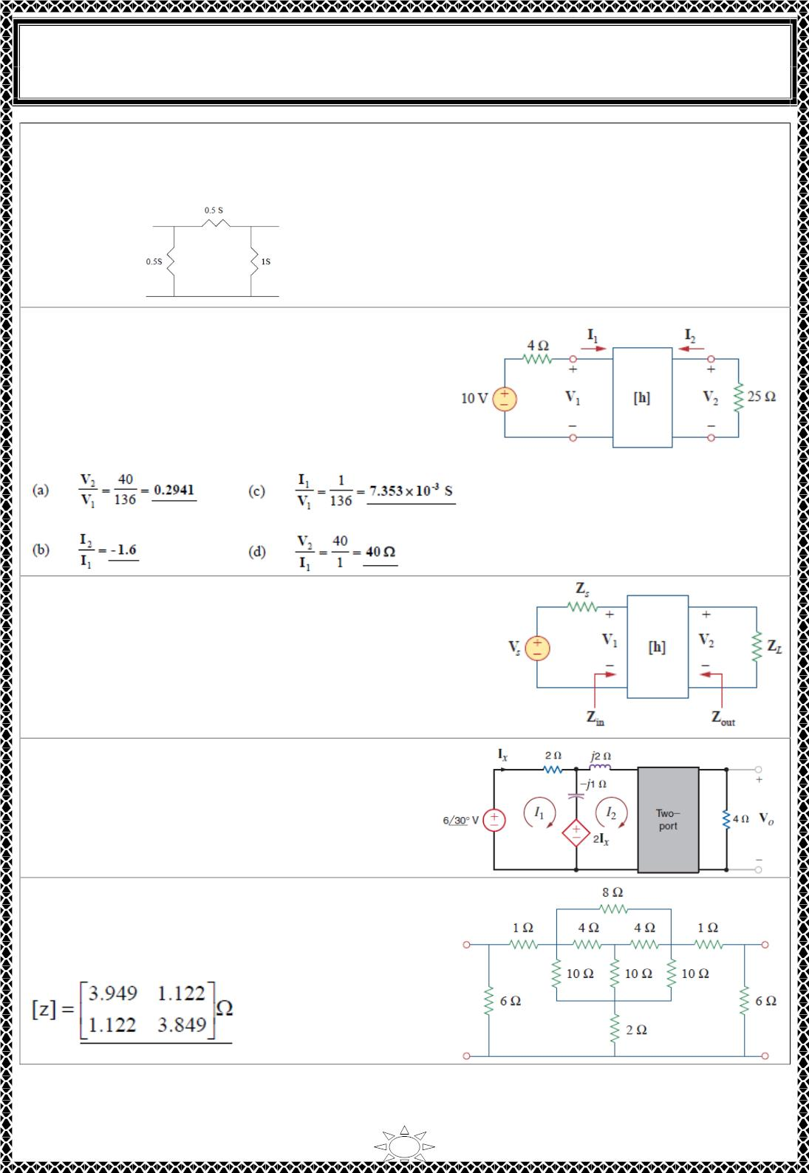
University of Diyala
Engineering College
Electronic Department
Electrical Circuits
2nd Class
Lecturer : Wisam N. AL-Obaidi
Year (2015-2016)
H.W.(13): Draw the two‐port network that has the following 푦 parameters:
−0.5
1
[푦] = ꢀ
−0.5 1.5
ꢁ 푆
[Answer:]
H.W.(14): For the two‐port in Fig.,
16Ω
−2 0.01 푆
[ℎ] = ꢀ
3
ꢁ
Find:
(a) 푉 /푉 (b) 퐼 /퐼
ꢂ
ꢃ
ꢂ
ꢃ
(c) 퐼 /푉 (d) 푉 /퐼
ꢃ
ꢃ
ꢃ
ꢂ
[Answer:]
Trail Version
Trail Version
Trail Version
Trail Version
Trail Version
Trail Version
Trail Version
Trail Version
Trail Version
Trail Version
Trail Version
Trail Version
Trail Version
H.W.(15): The ℎ parameters of the two‐port of Fig.
are:
600훺 0.04
[ℎ] = ꢀ
30
ꢁ
2 푚푆
Given the 푍 = 2푘훺 & 푍 = 400훺, Find 푍 and 푍_{표푢푡}.
푠
퐿
ꢄ
[Answer: Z = 333.33 Ω, Z = 650 Ω]
in
out
H.W.(16): Determine the output voltage 푉 in
표
the network in Fig. if the 푍 parameters for the
two‐ port are
5
4
푍 = ꢀ
ꢁ
[Answer: ]
4 12
H.W.(17): Obtain the 푧 parameters of the
network in Fig.
[Answer:]
3

Slide 5
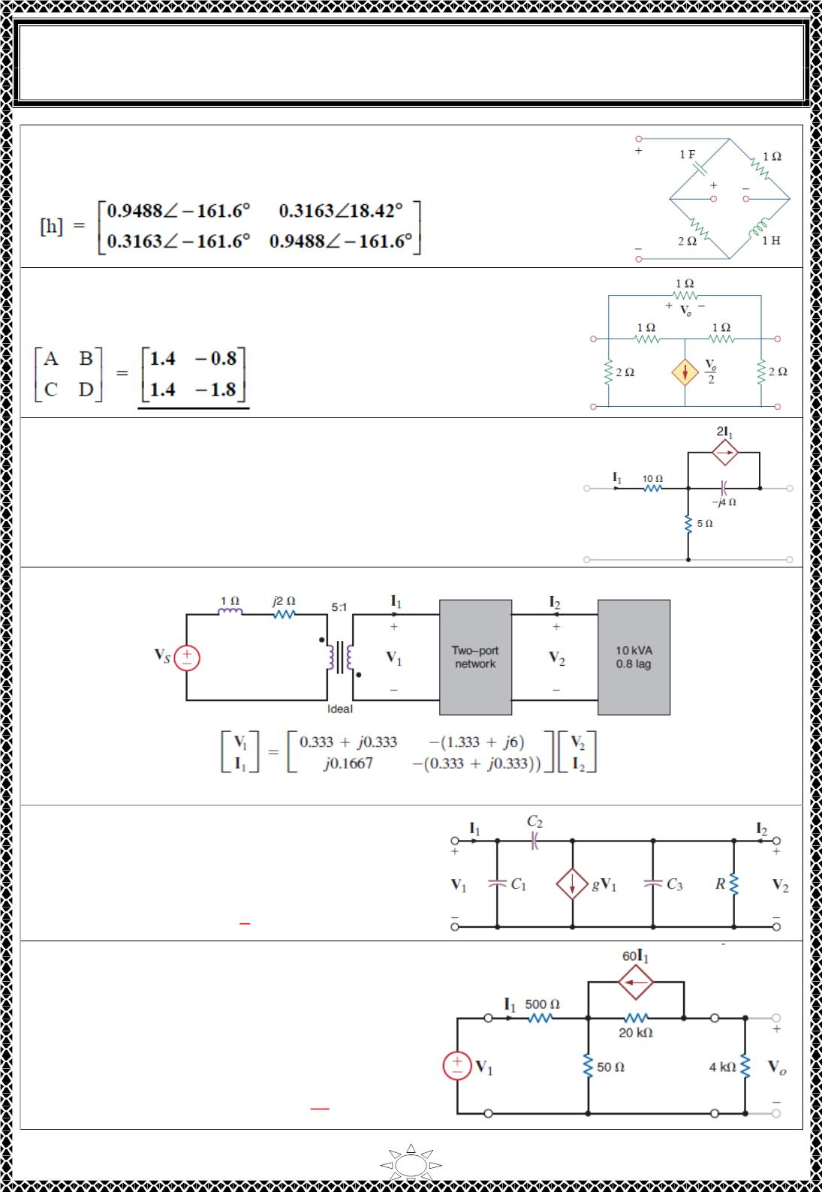
University of Diyala
Engineering College
Electronic Department
Electrical Circuits
2nd Class
Lecturer : Wisam N. AL-Obaidi
Year (2015-2016)
H.W.(18): Find the ℎ parameters of the network in Fig. Take 휔 =
1푟푎푑/푠.
[Answer:]
H.W.(19): Find the transmission parameters for the network in
Fig.
[Answer:]
H.W.(20): Find the Z parameters for the two-port network
shown in Fig.
Trail Version
Trail Version
Trail Version
Trail Version
Trail Version
Trail Version
Trail Version
Trail Version
Trail Version
Trail Version
Trail Version
Trail Version
Trail Version
[Answer: z = 15 Ω; z = 5 Ω; z = 5 - j8 Ω; z = 5 - j4 Ω]
11
12
21
22
H.W.(21): Find V if V = 220∠0° V rms in the network shown in Fig.
s
2
[Answer: Vs = 1015.9∠-137.63° V rms.]
H.W.(22): Determine the admittance
parameters for the network shown in Fig.
[Answer:
풋흎(푪 + 푪 )
−풋흎푪_{ퟐ}
[풚] = ꢀ
ퟏ
ퟐ
ퟏ
ꢁ]
품 − 풋흎푪_{ퟐ}
+ 풋흎(푪 + 푪 )
푹
ퟐ
ퟑ
H.W.(23): Determine the z parameters of the
network shown in Fig. and determine the
voltage gain of the entire circuit with 4 kΩ
load.
[Answer:
ퟓퟓퟎ Ω
ퟓퟎΩ
[풛] = ꢂ
^{푽}푶
−ퟏ. ퟐ 푴Ω ퟐퟎ. ퟎퟓ 풌Ω
ꢃ . = ퟔퟓ ∙ ퟓ]
^{푽}ퟏ
4

Slide 6
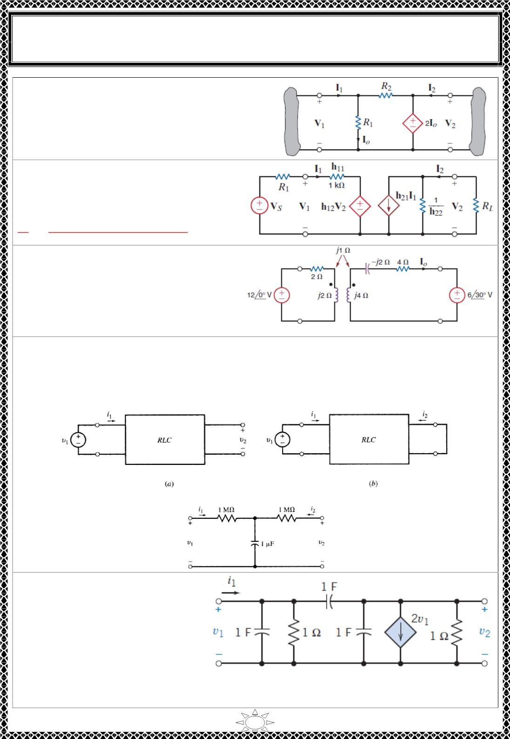
University of Diyala
Engineering College
Electronic Department
Electrical Circuits
2nd Class
Lecturer : Wisam N. AL-Obaidi
Year (2015-2016)
H.W.(24): Show that the network in Fig. does
not have a set of 푌 parameters unless the source
has an internal impedance.
[Answer: 풚_{ퟏퟏ} = 풚_{ퟏퟐ} = 풚_{ퟐퟏ} = 풚_{ퟐퟐ} = ∞]
H.W.(25): Consider the hybrid model
for a basic transistor. Determine the
voltage gain of the entire network, 푉 /푉 .
[Answer:
2
푆
^{푽}ퟐ
푽_{풔}
=
^{풉}ퟐퟏ^{푹}푳
]
풉_{ퟏퟐ}풉_{ퟐퟏ}푹_{푳}−(ퟏ+ 풉_{ퟐퟐ}푹_{푳})(풉_{ퟏퟏ}+ 푹_{푳})
H.W.(26): Find the transmission
parameters for the two‐port network and
then find 퐼_{표} using the terminal conditions.
[Answer: :
[푻] = ꢀ
ퟐ ꢁ 풋ퟐ (ퟏퟐ ꢁ 풋ퟓ) Ω
ꢂ ]
ꢁ풋 푺
H.W.(27): A two‐port network contains resistors, capacitors, and inductors only. With
^{−ꢃ}푢(푡)(휇퐴) 푣 =
ퟐ ꢁ 풋ퟒ
Trail Version
Trail Version
Trail Version
Trail Version
Trail Version
Trail Version
Trail Version
Trail Version
Trail Version
Trail Version
Trail Version
Trail Version
Trail Version
port 2 open [Fig.(푎)], a unit step voltage 푣 = 푢(푡) produces 푖 = 푒
and
2
1
1
(ꢄ ꢁ 푒^{−ꢃ})푢(푡)(푉). With port 2 short‐ circuited [Fig.(푏)], a unit step voltage 푣 = 푢(푡)
1
delivers a current 푖₁ = 0.5(ꢄ ꢅ 푒^{−2ꢃ)푢(푡)(휇퐴)}. Find and the T equivalent network.
푖
2
‐
[Answer: 풊_{ퟐ} = ퟎ. ퟓ(ꢁퟏ ꢅ 풆^{−ퟐ풕)풖(풕) [}see Fig.
(풄)]]
H.W. (28): (a) For the circuit
shown in Fig., determine the two-
port Y model using impedances in
the s-domain. (b) Determine the
response v₂(t) when a current
source i₁ =1 u(t) A is connected to
the input terminals.
[Answer:]
5

Slide 7
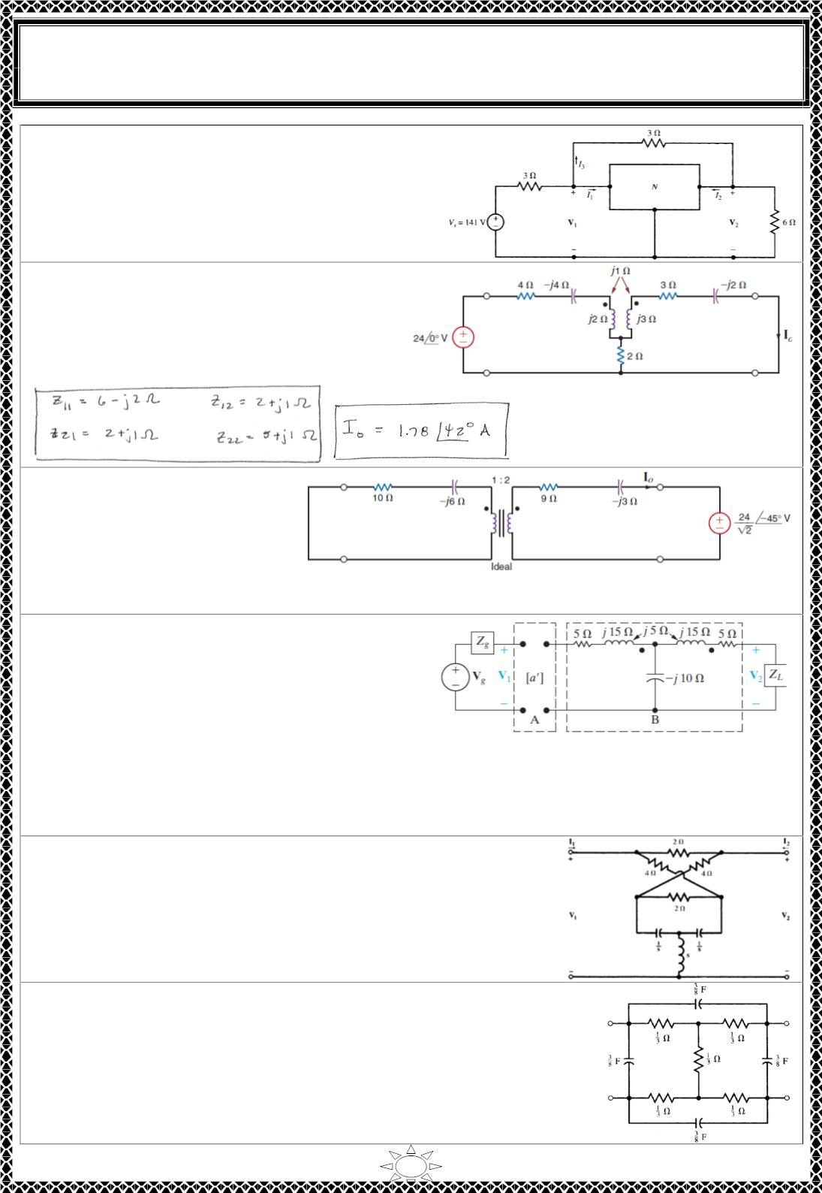
University of Diyala
Engineering College
Electronic Department
Electrical Circuits
2nd Class
Lecturer : Wisam N. AL-Obaidi
Year (2015-2016)
H.W.(29): The two-port network N in Fig. is
specified by Z =2, Z = Z = 1, and Z = 4.
11
12
21
22
Find I , I , and I .
1
2
3
[Answer: I = 24 A, I = 1.5 A, and I = 6.5 A]
1
2
3
H.W.(30): Find the 푍 parameters for the
two‐port network in Fig. and then
determine 퐼_{표} for the specified terminal
conditions.
[Answer: ]
H.W.(31): Find the
transmission parameters of the
two‐port in Fig. and then use
the terminal conditions to
compute 퐼_{표}.
[Answer: ]
H.W.(32): The networks A and B in the
circuit in Fig. are reciprocal and symmetric.
For network A, it is known that a =5 and b
=24 Ω.
Trail Version
Trail Version
Trail Version
Trail Version
Trail Version
Trail Version
Trail Version
Trail Version
Trail Version
Trail Version
Trail Version
Trail Version
Trail Version
a) Find the transmission parameters of
ퟎ
network B. b) Find V when V = ퟕퟓ∠ퟎ V,
ퟎ
2
g
Z = ퟏ∠ퟎ Ω, and Z =
ퟏퟎ∠ퟎ^{ퟎ}
Ω.
g
L
[Answer: (a) A = −ퟏ + 풋ퟏ, B = −ퟏퟎ + 풋ퟓ Ω, C = 풋ퟎ ∙ ퟐ 푺, D = −ퟏ + 풋ퟏ (b)V2 = −2.95 −
j2.79 V]
H.W.(33): Find the Z-parameters in the circuit of Fig.(Use
the series connection rule).
[Answer:
Z = Z = s + 3 + (1/s);
11
22
Z = Z = s + 1]
12
21
H.W.(34): Find the y-parameters in the circuit of Fig.(Use the
parallel connection rule).
[Answer: y = y = 9(s + 2)/16; y = y = - 3(s + 2)/16]
11
22
12
21
6

Slide 8
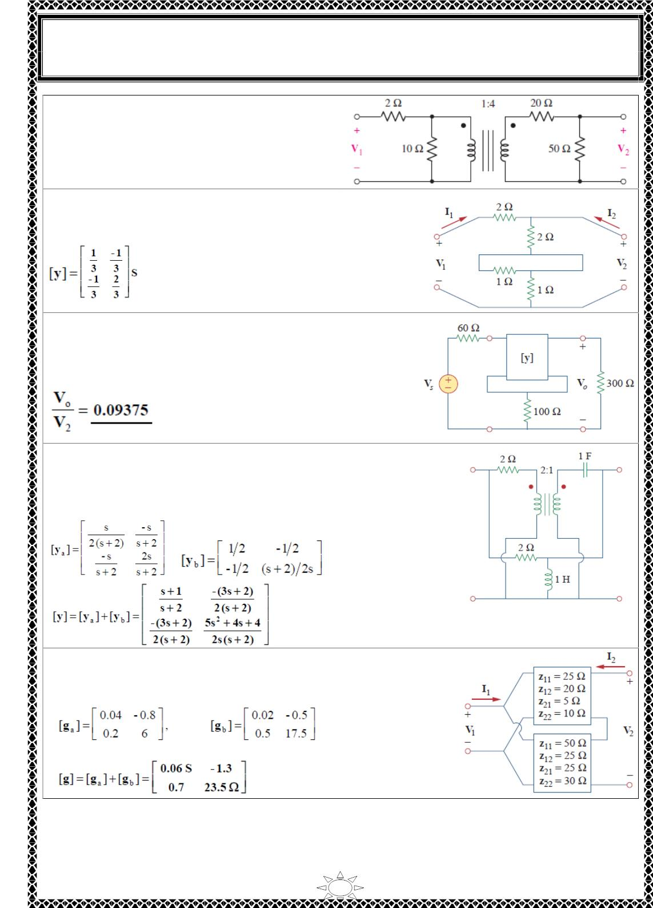
University of Diyala
Engineering College
Electronic Department
Electrical Circuits
2nd Class
Lecturer : Wisam N. AL-Obaidi
Year (2015-2016)
H.W.(35): By using the rules for
interconnecting two-ports in cascade, find t
for the network of Fig.
[Answer:]
H.W.(36): What is the 푦 parameter presentation of the
circuit in Fig. ?
[Answer:]
H.W.(37): In the two‐port of Fig., let 푦 = 푦 = 0,
12
21
푦 = ꢀ푚푆, and 푦 = ꢁ0푚푆. Find 푉 /푉 .
11
22
표
푠
[Answer:]
Trail Version
Trail Version
Trail Version
Trail Version
Trail Version
Trail Version
Trail Version
Trail Version
Trail Version
Trail Version
Trail Version
Trail Version
Trail Version
H.W.(38): The circuit in Fig. may be regarded as two
two‐ports connected in parallel. Obtain the 푦 parameters as
functions of s.
[Answer:]
H.W.(39): For the parallel‐series connection of the two
two‐ports in Fig., Find the ꢂ parameters.
[Answer:]
7

Slide 9
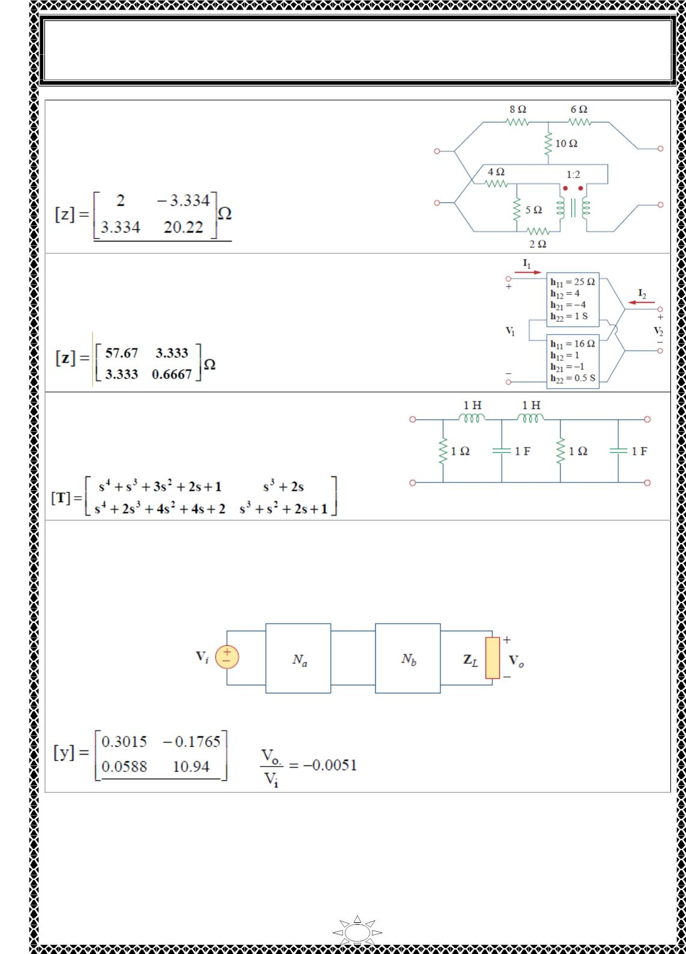
University of Diyala
Engineering College
Electronic Department
Electrical Circuits
2nd Class
Lecturer : Wisam N. AL-Obaidi
Year (2015-2016)
H.W.(40): Determine the 푧 parameters for the network
in Fig.
[Answer:]
H.W.(41): A series‐parallel connection of two two‐ports is
shown in Fig. Determine the 푧 parameter representation of the
network.
[Answer:]
H.W.(42): Determine the ABCD parameters of the
circuit in Fig. as functions of 푠. (Hint: Partition the
circuit into sub-circuits and cascade them using)
[Answer:]
Trail Version
Trail Version
Trail Version
Trail Version
Trail Version
Trail Version
Trail Version
Trail Version
Trail Version
Trail Version
Trail Version
Trail Version
Trail Version
H.W.(43): For the individual two‐ports shown in Fig. where,
[푧_{푎}] = {
8 6
4 5
} 훺 [푦_{푏}] = {
8 −4
2 10
} 푆
(a) Determine the 푦 parameters ofthe overall two‐port. (b) Find the voltage ratio 푉 /푉
when 푍_{퐿} = 2훺.
표
ꢀ
[Answer:]
,
8

Slide 10
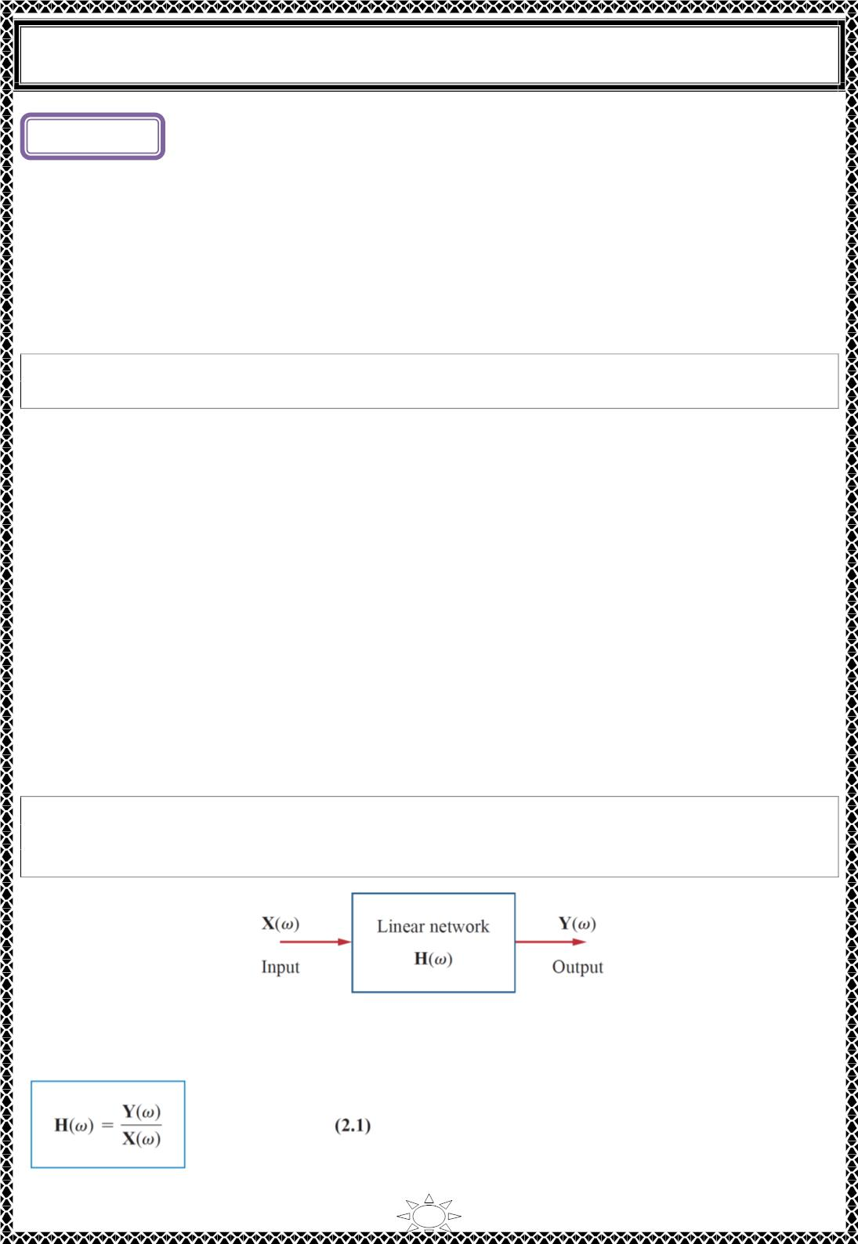
University of Diyala
Engineering College
Electrical Circuits
Lecture ( )
Frequency Response
1) Introduction
In our sinusoidal circuit analysis, we have learned how to find voltages and currents in a
circuit with a constant frequency source. If we let the amplitude of the sinusoidal source
remain constant and vary the frequency, we obtain the circuit’s frequency response. The
frequency response may be regarded as a complete description of the sinusoidal steady
state behavior of a circuit as a function of frequency.
The frequency response of a circuit is the variation in its behavior with change in
signal frequency.
The sinusoidal steady-state frequency responses of circuits are of significance in many
applications, especially in communications and control systems. A specific application is
in electric filters that block out or eliminate signals with unwanted frequencies and pass
signals of the desired frequencies. Filters are used in radio, TV, and telephone systems to
separate one broadcast frequency from another.
Trail Version
Trail Version
Trail Version
Trail Version
Trail Version
Trail Version
Trail Version
Trail Version
Trail Version
Trail Version
Trail Version
Trail Version
Trail Version
2) Transfer Function
The transfer function 푯(흎) (also called the network function) is a useful analytical tool for
finding the frequency response of a circuit. In fact, the frequency response of a circuit is
the plot of the circuit’s transfer function 푯(흎) versus 흎, with 흎 varying from 흎 = ퟎ to
흎 = ∞.
A transfer function is the frequency-dependent ratio of a forced function to a forcing
function (or of an output to an input). The idea of a transfer function was implicit when we
used the concepts of impedance and admittance to relate voltage and current. In general, a
linear network can be represented by the block diagram shown in Fig.2.1.
The transfer function H(흎) of a circuit is the frequency-dependent ratio of a phasor
output Y(흎) (an element voltage or current) to a phasor input X(흎) (source voltage
or current).
Fig.2.1. A block diagram representation of a linear network.
Thus,
1

